Slide 1
Working with function
Introduction
Understanding functions
Defining function in python
Flow of execution in a function call
Passing parameters
Returning values from function
Composition
Scope of Variables
By : Mohit Bisht

Slide 2
Introduction
Large program generally avoided because it is difficult to manage big program, Thus large program is broken down into smaller units known as function.
A function is a block of code which only runs when it is called
The most important reason to use functions is to make program handling easier as only a small part of the program is dealt with time, thereby avoiding ambiguity.
Function make a program more readable and understandable to a programmer thereby making program management much easier.
The idea is to put some commonly or repeatedly done task together and make a function so that instead of writing the same code again and again for different inputs, we can call the function to reuse code contained in it over and over again.

Slide 3
Understanding function
To understand the function let’s take below example of polynomials is Mathematics.
2x^2
For x=1, 2*1*1=2
For x=2,2*2*2=8
For x=3,2*3*3=18
and so on
Now if we represent above polynomials as below
f(x)=2*x^2
The we can say(from above calculations):
f(1)=2
f(2)=8
f(3)=18
The notation f(x)=2*x^2 terms as “function” where f is function ,x is its arguments and 2*x^2 the functionality it perform.
On similarly line programming language also support functions, Functions in programing language have below components.
Arguments
Functionality
Return result

Slide 4
For instance, Mathematical function f(x) can be written in python as below
def cal(x):
r=2*x**2
return r
Where
def mean a function definition.
Identifier followed by def is the name of function i.e. cal
Variables inside the parentheses is arguments(Values given to function) i.e. x
Colon at the end of def line.
Statement or functionality indented inside the function called body of function
return statement returns the compute result

Slide 5
calling /Inworking/using a function
syntax:function-name(value to be passed to argument)
def cal(x):
r=2*x**2
return r
a=int(input(“Enter the number: “))
print(cal(a))
Or
def cal(x):
r=2*x**2
return r
a=int(input(“Enter the number: “))
result=cal(a)
print(result)

Slide 6
Python function types
Built-in function: These are the pre-defined functions and are always available to use.
Example:len(),print(),type()
Function defined in modules: These function are pre-defined in particular modules and can only be used when corresponding module is imported. For example: for using sin() function we have to import math module(import math)
User defined functions: These are defined by the programmer.

Slide 7
Defining function in python
As you know now that we write program to do certain things. Function can be thought as key-doer within a program. A function once defined can be invoked as many times as needed by using its name.
A function can be defined as below
def function_name(parameters):
[“ ” ”function doc string” ” ”]
Statement
Statement
-
Example:
def sum(x,y):
s=x+y
return s
Or
def greet():
print(“Good Morning”)

Slide 8
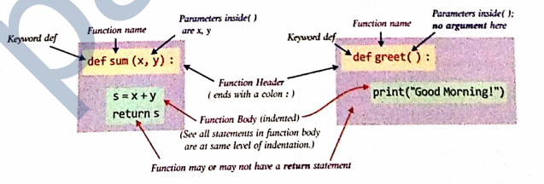
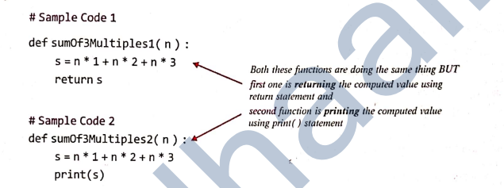

Slide 9
Structure of a Python Program
In python program, Generally all the function definitions are given at the top followed by the statements which not part of functions(top-level statements).
The python interpreter starts the execution of a program/script from top-level statements
The top level statements are part of the main program. Internal python gives a special name to top-level statements as __main__
Structure:
def function1:
-
def function2:
-
def function3:
-
#top level statement
Statement1
Statement2
Python stores name in a built-in variable called __name__.
prin(__name__)

Slide 10
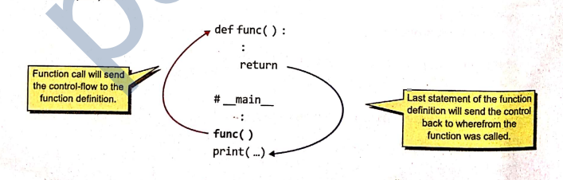
Flow of execution in a function call
Whenever a function call statement is encountered, an execution frame for the called function is created and the control is transferred to it.
Within the function execution frame the statement in the funcion body are executed and with the return statement or the last statement of the function body, the control return to the statement wherfrom the function is called.
Program execution begins with first statement of __main__ segment.

Slide 11
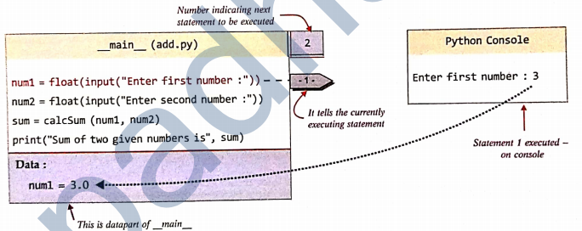
Example:
def calcSum(x,y):
s=x+y
return s
num1=float(input(“Enter first number: “))
num2=float(input(“Enter second number: “))
sum=cal(num1,num2)
print(“Sum of two given number is : “,sum)

Slide 12
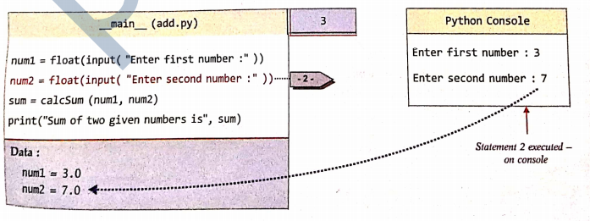

Slide 13
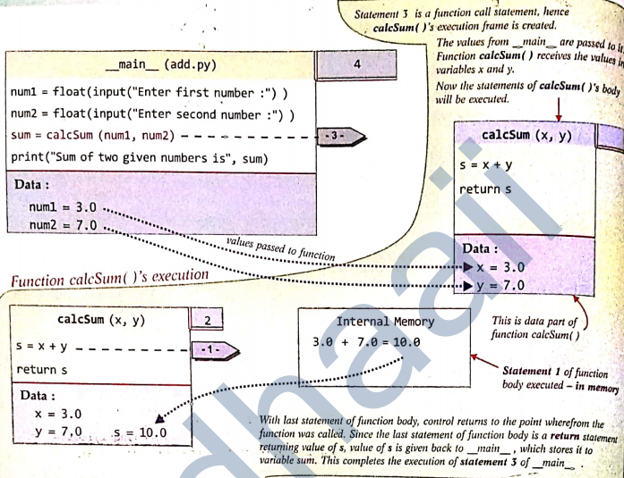

Slide 14
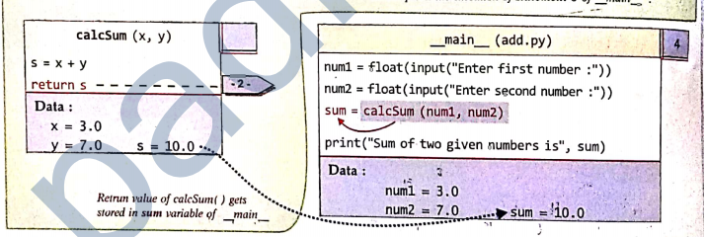
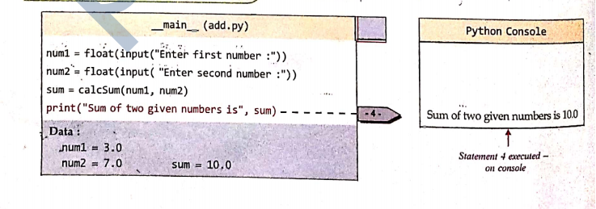
main.1-->main.2-->main.3-->calcSum.1-->calcSum.2-->main.3-->main.4

Slide 15
Arguments and Parameters
Python supports three type of formal argument/parameter.
Positional arguments
Default arguments
Keyword arguments
Positional arguments: The arguments must be provided to all the parameters, The value of arguments are matched with parameters
def check(a,b,c):
-
-
The possible function call
check(1,2,3)
x=2
y=3
check(1,x,y)
x=1,y=2,z=3
check(x,y,z)

Slide 16
Default arguments: Default values are specified in the function header of function definition.
def interest(p,i,r=0.10): [0.10 is default value for parameter r(rate), If in function call if value of r is not provided then it will take default value]
Function call
si_int=interest(5400,2) # Third argument missing.
si_int=interest(6100,3,0.15) # No arguments are missing
In function header , any parameter cannot have default value unless all the parameters appearing on its right have their default values.
def interest(p,t,r=1): #valid
def interest(p,t=100,r): #invalid
def interest(p=1000,,t=100,r): #invalid
def interest(p,t=100,,r=1): #valid
def interest(p=1000,,t=100,,r=1): #valid

Slide 17
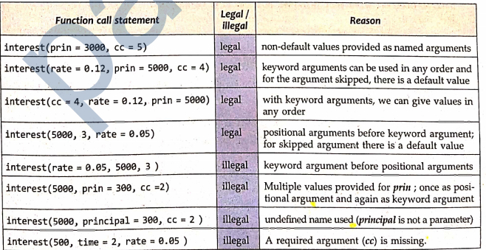
Keyword argument: You can write argument in any order while calling function.
def interest(p,i,r):
interest(r=1,t=6,p-100)
Multiple type arguments together:

Slide 18
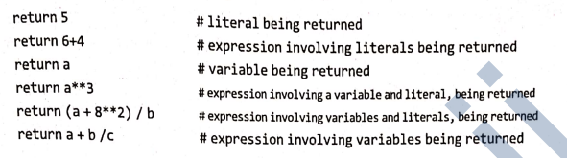
Returning values from functions
There are two type of functions depending upon returning the value.
Functions returning some value (non-void function)
Function not returning any value (void function)
Non Void Function: The function that return some computed result in term of a value, The compute value is returned using return statement .Value being returned can be of following form
A literal
A variable
An Expression
Functions returning the a value are also known as fruitful functions

Slide 19
Example
def sum(x,y):
s=x=y
return s
result =sum(5,3) #The returned value from sum() will replace this function call, So result=8
Other example:
add_result=sum(5,6) #The returned value being used in assignment statement
print(sum(5,6) ) #The returned valued being used in print statement
sum(4,5)>6 #the returned valued being used in relational expression
The return statement ends a function execution even if it is in the middle of the function.
def sum(x,y):
s=x=y
return s
print(s) # This statement is unreachable because sum function end with return
result =sum(5,3)

Slide 20
Void Function: The function perform actions but not return any value, A void function may or may not have return statement but return statement have not value
Void function called non fruitful funcation
def geet():
print(“hello”)
or
def geet():
print(“hello”)
return
or
def sum(a,b):
s=a+b
print(s)
or
def sum(a,b):
s=a+b
print(s)
return

Slide 21
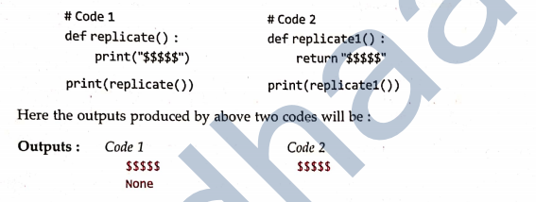
Function call will be not part of any statement, They will be standalone
greet()
sum()
Example:
def geert():
print(hello)
a=greet() #Output : hello
print(a) #output: None

Slide 22
Returning multiple value
Return statement for returning multiple value
Return value,value,value…..
Return in form of tuple.
def squared(x,y,z):
return x*x,y*y,z*z
t=squared(2,3,4)
print(t) #output: (4,9,16)
or
t1,t2,t3=squared(2,3,4)
print(t1) #output: 4
print(t2) #output: 9
print(t3) #output: 16

Slide 23
Composition
Composition in general refers to using an expression as part of a larger expression or a statement as a part of larger statement.
Example:
-Arithmetic expression
greater((4+5),(3+4))
-Logical expression
test(a or b)
-Function call
int(str(52))
int(str(52)+str(10))

Slide 24
Scope of variables
Scope rules of a language are the rules that decide, in which part of the program, a particular piece of code or data item would be know and can be accessed therein.
Example:
Suppose you are touring historical monuments. To visit a monuments you have to buy tickets, you buy ticket (Ticket1) to go monument A. As long as you are inside monument A your Ticket1 is valid. But movement you come out from monument A validity of Ticket1 is over. You can’t visit another monument with Ticket1. To visit monument B you need buy another ticket(Ticket2) So we can say scope of Ticket1 is monument A and scope of Ticket2 is monument B.
Ticket1 ----> Monument A
Ticket2 ----> Monument B
Suppose there is another type of ticket (Ticket3) city based ticket using which you can visit all the monuments of city. So we can say Ticket3 have scope of all monument in city including monument A and B.
Ticket3 ----> All monuments in city

Slide 25
In program we can say that scope refer to part of program within which different name or variable have access.
In python there are two type of scope Global and Local.
Global Scope: A name declared in top level program (__main__) of a program is said to have Global scope and is usable inside whole program and block.
Local Scope: A name declare inside function body is said to have Local scope , It can be used inside function only.
Example:
def cal(x,y):
z=x+y
return z
num1=int(input(“Enter first number: “))
num2=int(input(“Enter second number: “))
sum=cal(num1,num2)
print(“Addition : “,sum)
Num1,num2,sum ---->Global scope
x,y,z-----> Local scope
Variable defined outside function is Global variable. Inside function is Local variable.
The lifetime of variable is time for which a variable lives in memory, For Global variable lifetime is entire run of program, For local variables, lifetime is function run

Slide 26
Name Resolution
For every name within a program i.e. when you access a variable from within a program or function, Python follows name resolution rule also know as LEGB rule.
It checks within its Local environment (LEGB) (or local namespace) if it has a variable within same name, if yes, Python uses its value, If not then below next below step.
Python now checks the Enclosing (nested function)environment (LEGB) (e.g, if whether there is a variable with the same name; if Yes, Python uses its value, If not then below next step follows.
Python now check the Global environment(LEGB) whether there is a variable with the same name, if Yes, Python uses its value, If not, then below next step follows.
Python check its Built-in environment(LEGB) that contains all built-in variable and function of python, if there is a variable with same name; If Yes, Python uses its value.
Otherwise Python would report the error.
Name <variable> not defined.

Slide 27
LEGB rule of namespace scope
Built in Namespace 4
Global namespace 3
Enclosing namespace 2
Local namespace 1

Slide 28
Example:
def cal (x,y):
s=x+y
print(num1)
return s
num1=int(input(“Enter the first number: ))
num2=int(input(“Enter the second number: ))
sum=cal(num1,num2)
print(sum)
Python will first check the local environment cal(),num1 is not found there
There is not enclosing environment
Python check Global environment, Python find num1 and print same

Slide 29
Mutable/Immutable properties of passed data object
Python’s variables are not storage containers, rather Python variable are like memory reference they refer to the memory address where the value is stored.
Depending upon the mutability/immutability of its data type, a variable behaves differently.
If variable is immutable type then any change in its value will also change memory address it is referring
If variable is mutable type then any change in the value of mutable type will not change the memory address of the variable.

Slide 30
148200 148216 148232 148248 148264 148280 148296 148312
Code: list1 (200160)
list1=[1,3]
var1=1
var1
0
1
2
3
4
5
6
7
0
1
Var1 stores the memory reference of integer 1 (i.e. 148216) as it is currently storing 1
List has been allocated address 200160 where it can store memory reference of its individual items e.g list1[0] currently stores here memory reference of integer value 1 i.e. 148216

Slide 31
Now if we are making changes to List1 and var1
var1=var1-1 # Now var1 holds value 1
list1[0]=3 #Now first item of list1 is also3
148200 148216 148232 148248 148264 148280 148296 148312
Var1 list1(200160)
0
1
2
3
4
5
6
7
0
1
The memory allocated list1 where it can hold its data item memory address remain same but list1[0] and list[1] holding same memory location
Var1 now stores memory address of integer 0(148200)

Slide 32
Mutability/Immutability of Arguments/Parameters and Function call
Example code 1:
1.def myFunc1(a):
2. print(“Inside myFun1”)
3. print(“Value received of a”,a)
4. a=a+2
5. print(“a value now”,a)
6. print(“returning from function myFunc1”)
7.
8. num=3
9. print(“calling function myFunc1 and passing num value”,num)
10. myFunc1(num)
11. print(“Back from myFunc1 and value of num is”,num)

Slide 33
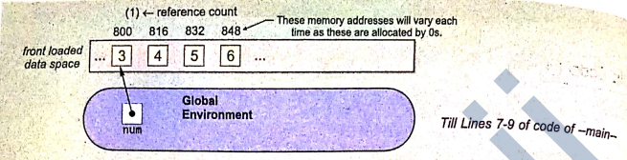
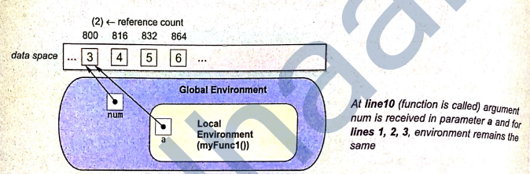

Slide 34
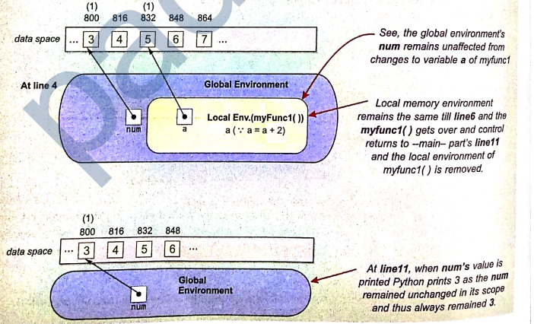

Slide 35
Example code 2
def myFunc2(myList):
print(“Inside called function”)
print(“received List”,myList)
myList[0]+=2
print(“List inside function after change”,myList)
return
List1=[1]
print(“List before function call”, List1)
myFunc2(List1)
print(“List after function call”, List1)

Slide 36
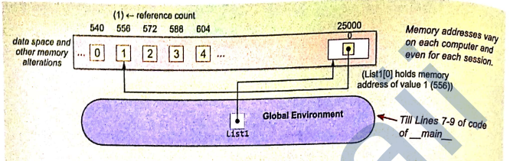
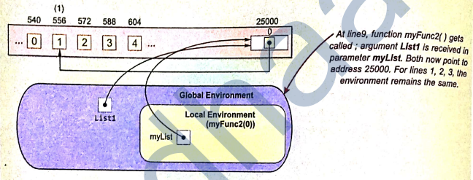

Slide 37
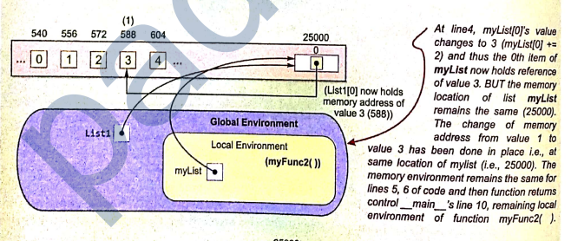
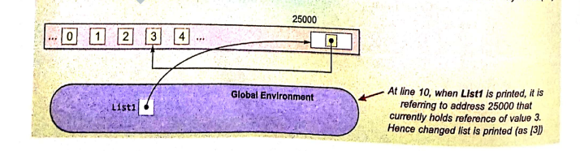

Slide 38
Similarly if you make other changes such as adding or deleting items from a passed list these will also get reflected back
Example code 3:
def myFucn3(myList):
print(“Inside call function”)
print(“recevied list”,myList)
myList.append(2)
myList.extend([5,1])
print(“List after adding an elements”,myList)
myList.remove(5)
print(“list after all the changes inside function”, myList)
Return’
List1=[1]
print(“List before function call”,List1)
myFucn3(list1)
print(“List after function call”,List1)

Slide 39
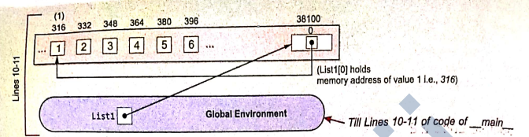
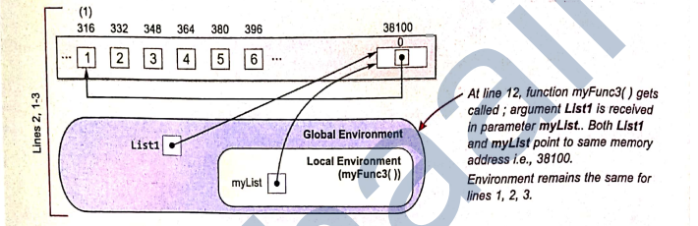

Slide 40
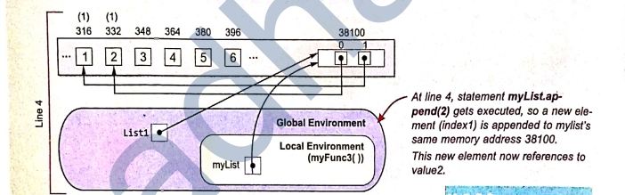
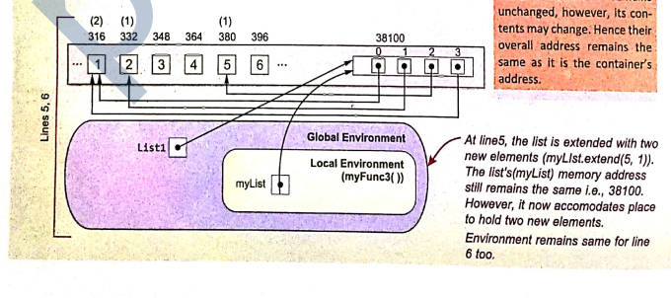

Slide 41
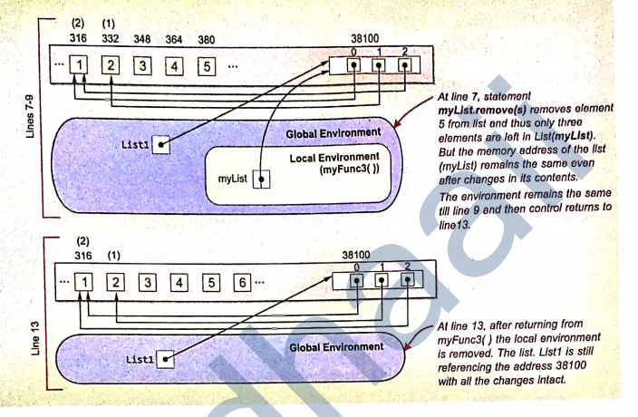

Slide 42
Passing mutable Type value to a function but assigning parameter to a new value/Variable
def myFunc4(myList):
print(“Inside function”)
print(“List received “,myList)
new=[3,5]
myList=new
myList.append(6)
print(“List change in function”,myList)
return
List=[1,4]
print(“List before function call:”,List)
myFunc4(List)
print(“List after function call:”,List)

Slide 43
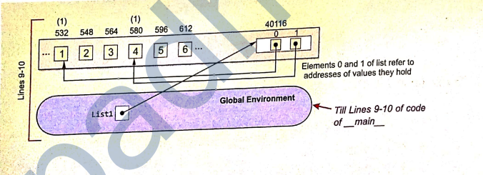
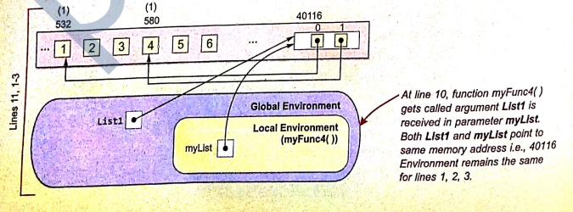

Slide 44
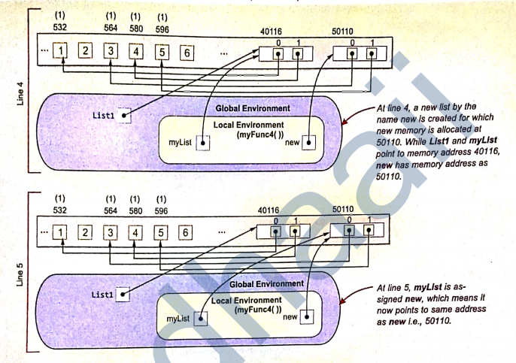

Slide 45
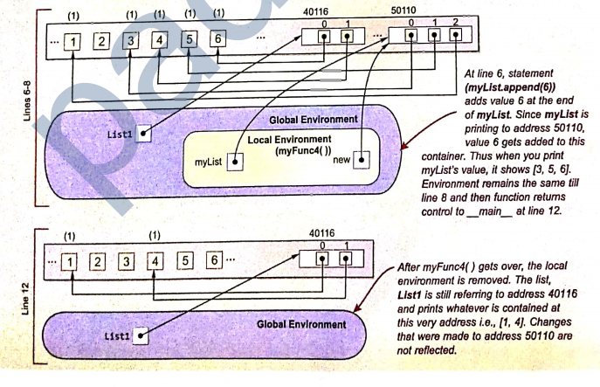

Slide 46
Assignments
What is the significance of having function in a program?
What is the default return value for a function that does not return any value?
What is the output of below program?
def addEm(x,y,z):
print(x+y+z)
def prod(x,y,z):
return x*y*z
a = addEm(6,12,26)
b= prod(2,3,6)
print(a,b)
Which will cause error among below function header?
def func(a=1,b)
def func(a=1,b,c=2)
def func(a=1,b=1,c=2))
def func(a=1,b=1,c=2,d)

Slide 47
What is the difference between Local variable and Global variable?
Output of below program?
def increase(x):
a=a+x
return
a=20
b=5
increase(b)
print(a)
Name local, global variable in below program?
i=”big names”
p=200
l=1
def play():
m=l+10
print(len(i)==0)
return m
r=play()
print(r)

Slide 48
Output of below program
a=1
def fun():
a=10
print(a)
Write function that receives an decimal number and convert number to binary, ocatal, hex decimal number
What are arguments and Parameter?
What is default and keyword arguments?
Difference between fruitful and non-fruitful function?
What is difference between global and local variable
Write a function takes amount in dollar and convert to rupees?
Write a function that receives two strings as arguments and check strings are of same length or not

